Slide 1
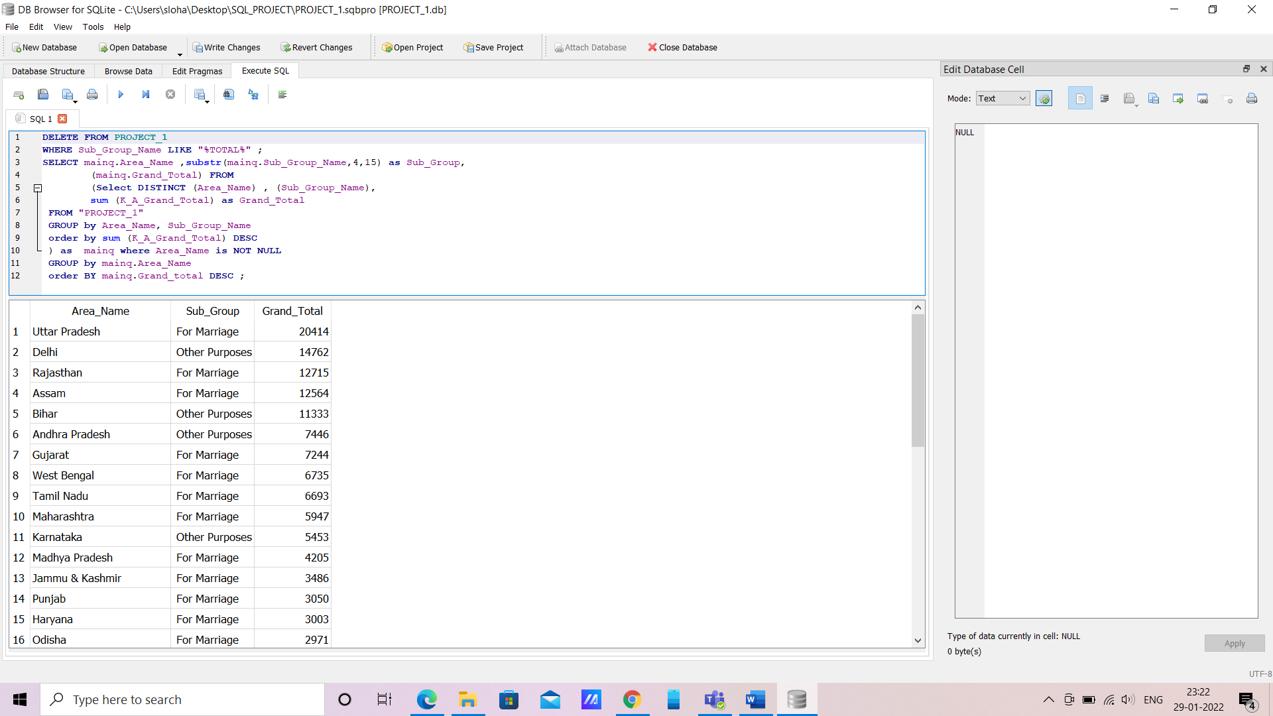
Q1. What is the major reason people being kidnapped in each and every state?
: DELETE FROM PROJECT_1
WHERE Sub_Group_Name LIKE "%TOTAL%" ;
SELECT mainq.Area_Name ,substr(mainq.Sub_Group_Name,4,15) as Sub_Group,
(mainq.Grand_Total) FROM
(Select DISTINCT (Area_Name) , (Sub_Group_Name),
sum (K_A_Grand_Total) as Grand_Total
FROM "PROJECT_1"
GROUP by Area_Name, Sub_Group_Name
order by sum (K_A_Grand_Total) DESC
) as mainq where Area_Name is NOT NULL
GROUP by mainq.Area_Name , Year
order BY mainq.Grand_total DESC ;

Slide 2
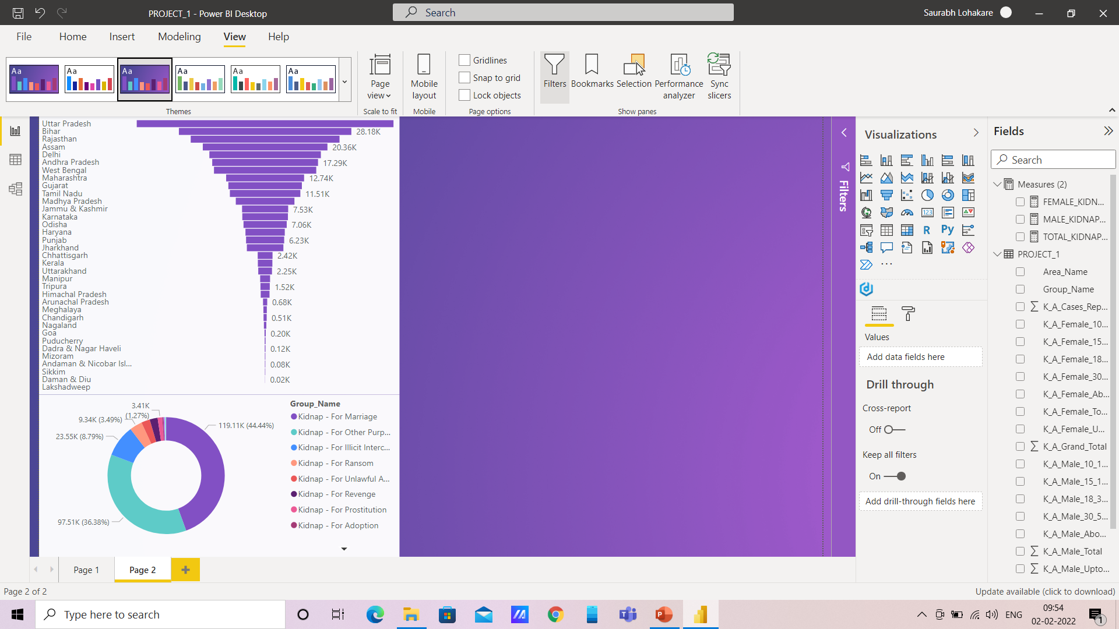
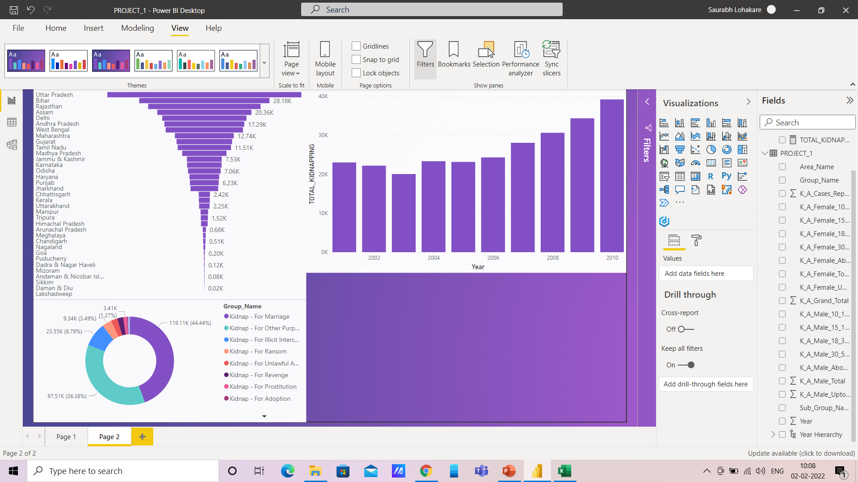
CONCLUSION:
Maximum number of cases of kidnappings & abductions were registered in Uttar Pradesh (41,952 cases) In 2001-2010.
Marriage was the main cause of kidnapping & abduction of females accounting for 60.74% (116,732 out of 192,175) of the total female kidnapped/ abducted & For Other Purpose is the main cause of kidnapping & abduction of males
Accounting for 70% (53,804 out of 75,826).
The number of victims was higher in the age group of 18 years & above – below 30 years.

Slide 3
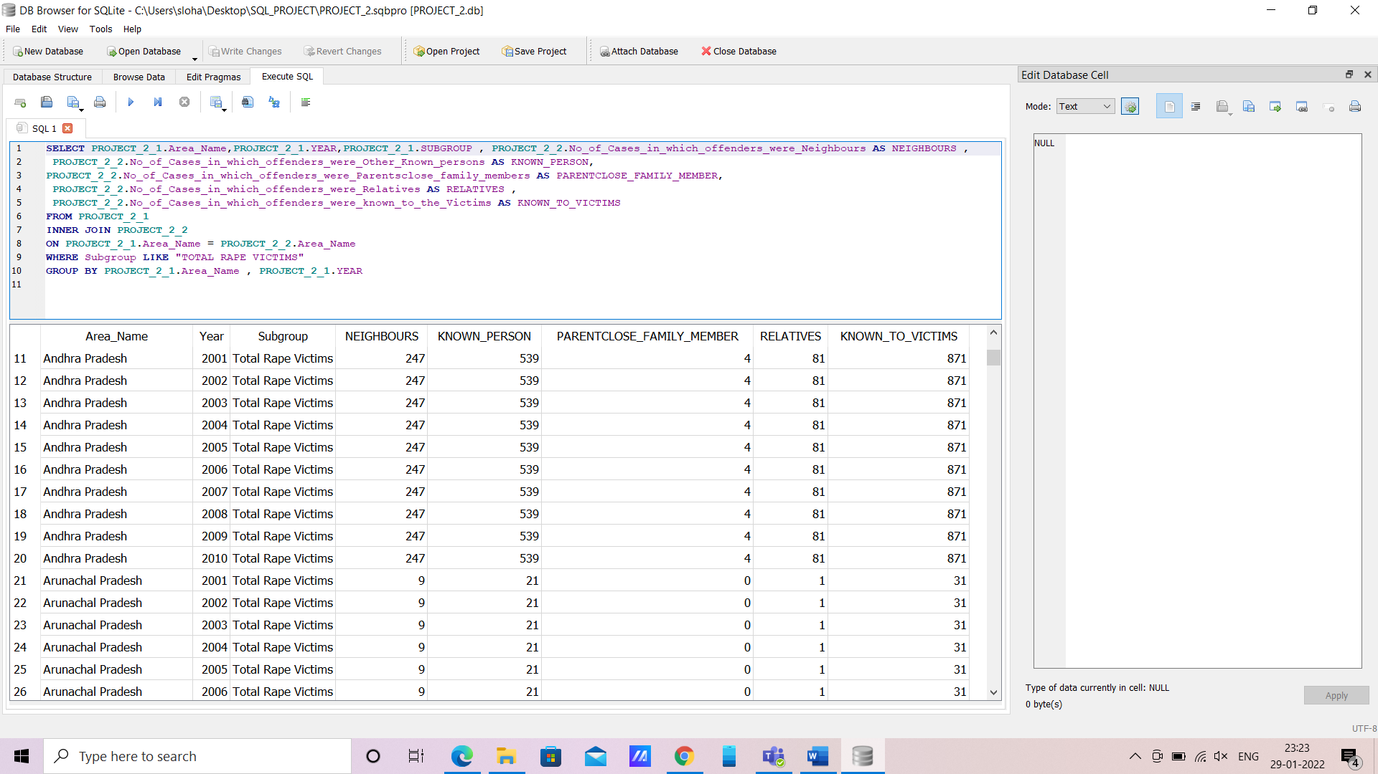
Q2. Offenders relation to the rape victim.
: SELECT PROJECT_2_1.Area_Name,PROJECT_2_1.YEAR,PROJECT_2_1.SUBGROUP , PROJECT_2_2.No_of_Cases_in_which_offenders_were_Neighbours AS NEIGHBOURS ,
PROJECT_2_2.No_of_Cases_in_which_offenders_were_Other_Known_persons AS KNOWN_PERSON,
PROJECT_2_2.No_of_Cases_in_which_offenders_were_Parentsclose_family_members AS PARENTCLOSE_FAMILY_MEMBER,
PROJECT_2_2.No_of_Cases_in_which_offenders_were_Relatives AS RELATIVES ,
PROJECT_2_2.No_of_Cases_in_which_offenders_were_known_to_the_Victims AS KNOWN_TO_VICTIMS
FROM PROJECT_2_1
INNER JOIN PROJECT_2_2
ON PROJECT_2_1.Area_Name = PROJECT_2_2.Area_Name
WHERE Subgroup LIKE "TOTAL RAPE VICTIMS"
GROUP BY PROJECT_2_1.Area_Name , PROJECT_2_1.YEAR

Slide 4
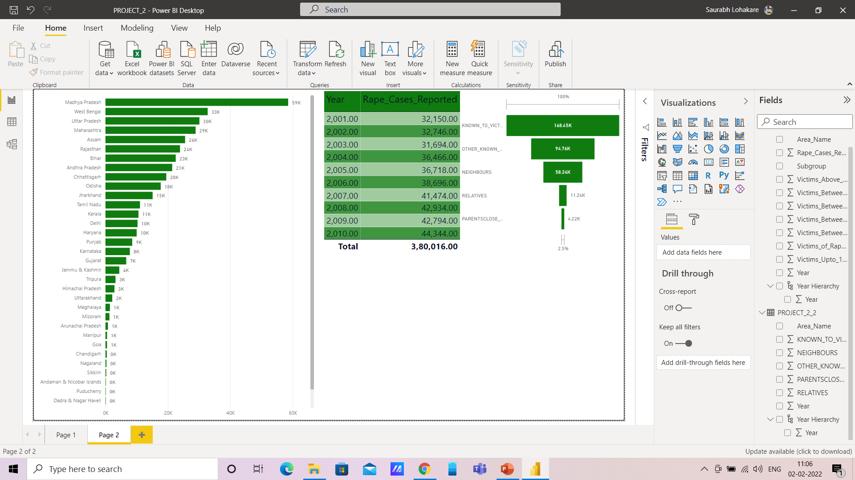
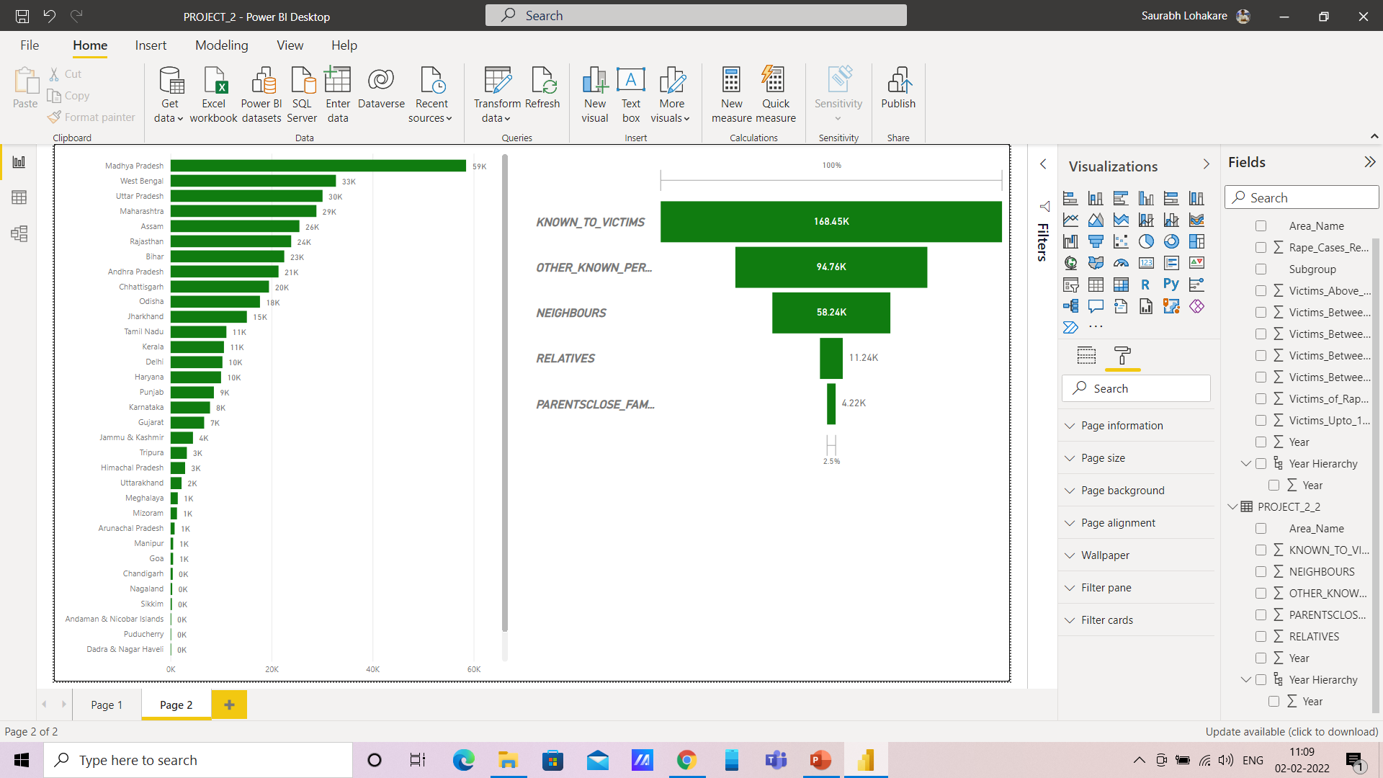
CONCLUSION:
Rape is the fourth most common crime against women in India. According to Data, 3,80,016 rape cases reported (2001-2010) across the country, or an average of 104 cases daily.

Slide 5
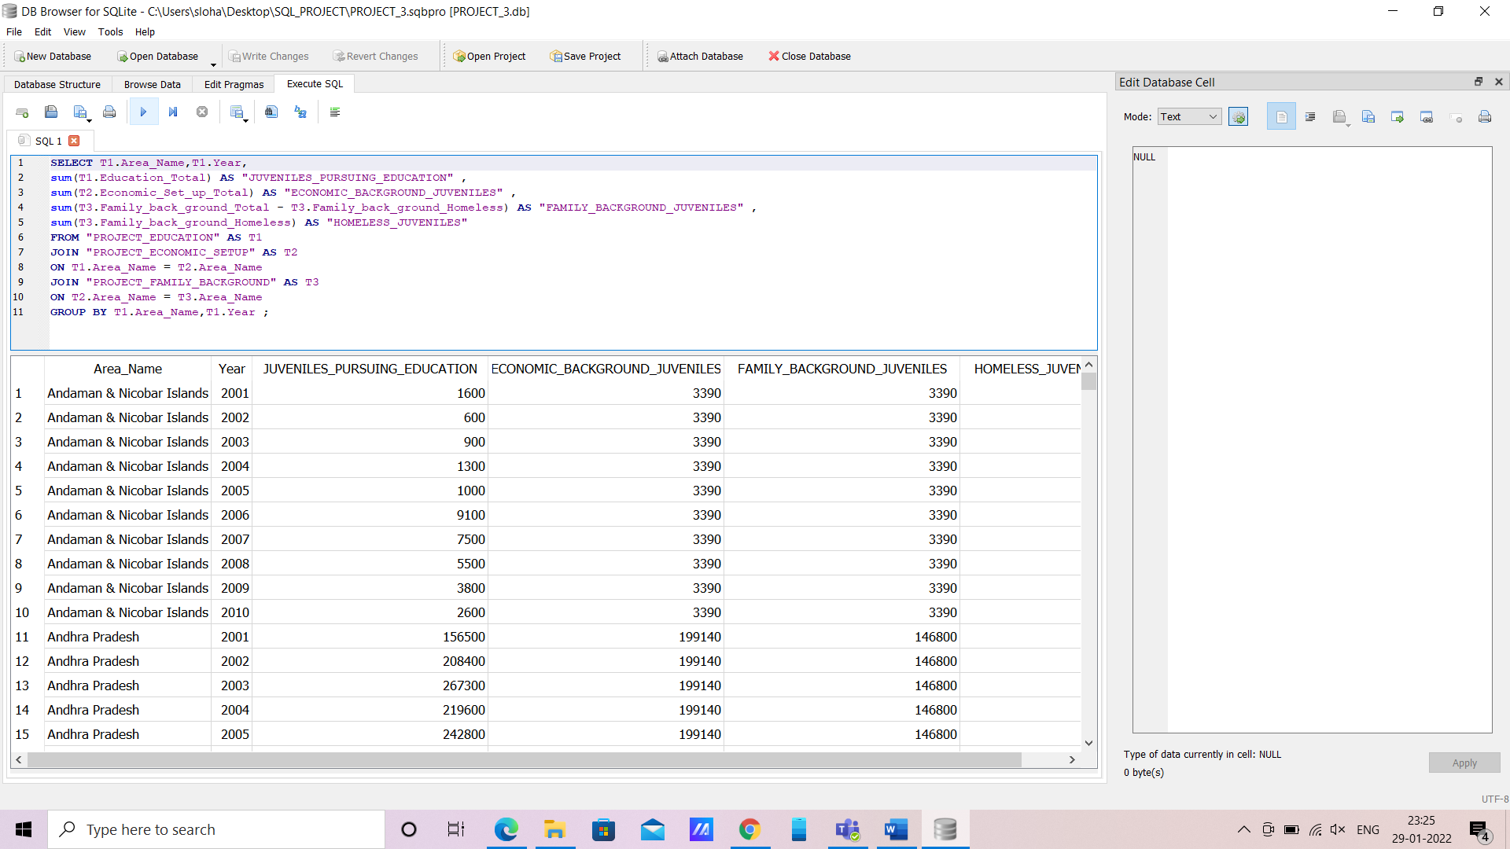
Q3. Juveniles family background, education and economic setup.
: SELECT T1.Area_Name,T1.Year,
sum(T1.Education_Total) AS "JUVENILES_PURSUING_EDUCATION" ,
sum(T2.Economic_Set_up_Total) AS "ECONOMIC_BACKGROUND_JUVENILES" ,
sum(T3.Family_back_ground_Total - T3.Family_back_ground_Homeless) AS "FAMILY_BACKGROUND_JUVENILES" ,
sum(T3.Family_back_ground_Homeless) AS "HOMELESS_JUVENILES"
FROM "PROJECT_EDUCATION" AS T1
JOIN "PROJECT_ECONOMIC_SETUP" AS T2
ON T1.Area_Name = T2.Area_Name
JOIN "PROJECT_FAMILY_BACKGROUND" AS T3
ON T2.Area_Name = T3.Area_Name
GROUP BY T1.Area_Name,T1.Year ;

Slide 6
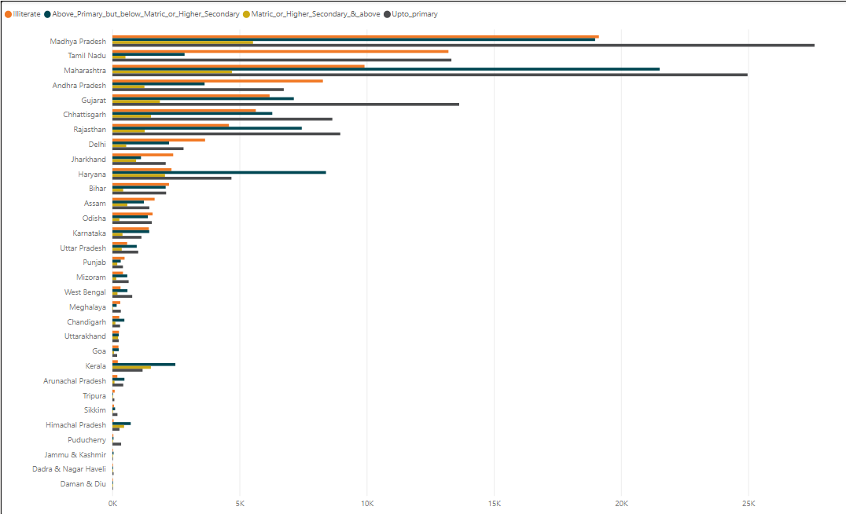

Slide 7
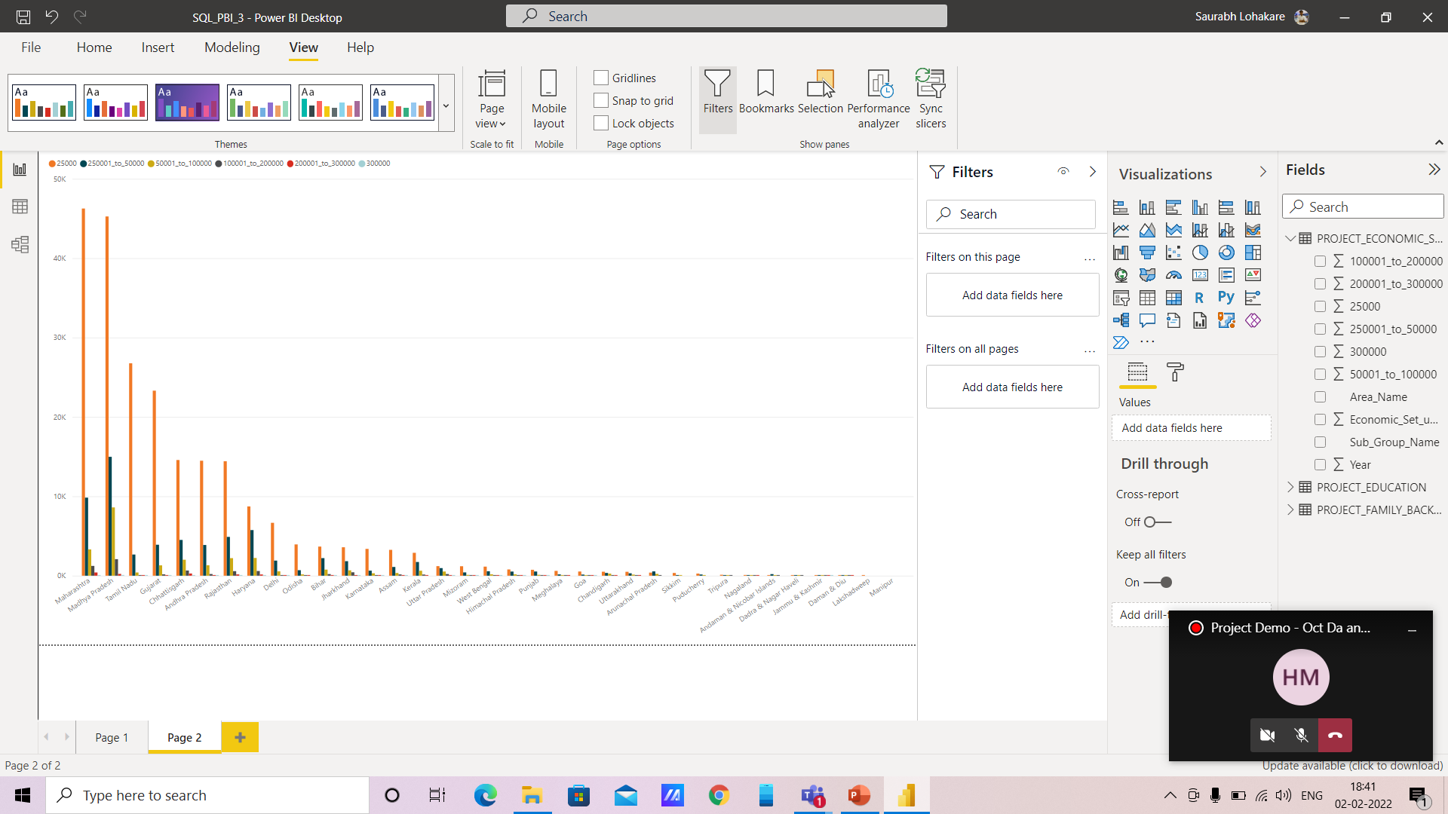
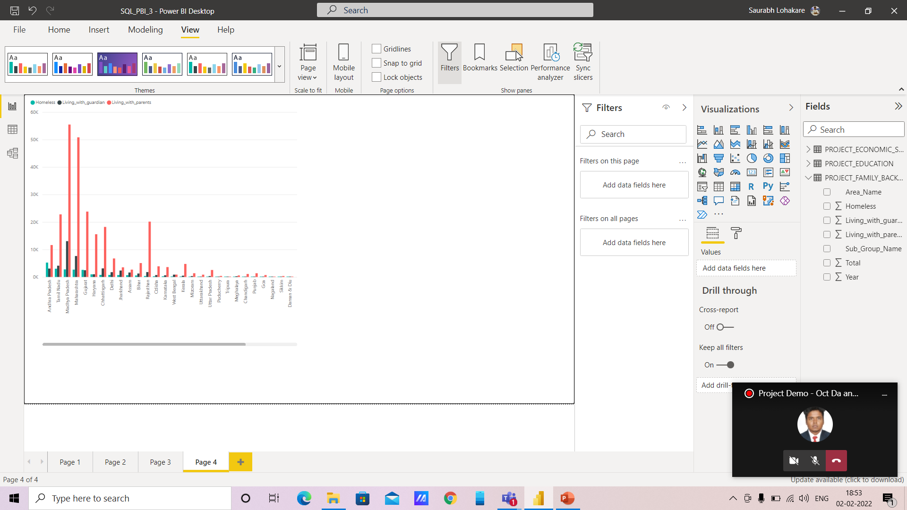
CONCLUSION:
As according to education, people who are illiterate & student who haven’t completed SSC are involved In crime more than students who have completed metric and are studying in 11th or 12th class.
So we can conclude that people who know importance of higher education are less involved in crime.
According to income wise crime, people who earn less are more involved in crime.
Also the kids who live with their parents/guardians are more involved in crime than kids who are homeless, so this might be due to - (A) lack of parental control & disturbed environment in family
(B) Total number of homeless are less (compared to others) so percentage wise they are less juveniles.

Slide 8
Q4. Which state has more crime against children and women?
: SELECT TC."STATE/UT" , TC."Total_Crimes_Against_Children" , TC."Total_Crimes_Against_Women"
FROM
(SELECT t1."STATE/UT" ,
sum (t1.Total_Crimes + t2.Total_Crimes)
As "Total_Crimes_Against_Children" ,
sum(T3.Rape + T3.KidnappingandAbduction + T3.DowryDeaths +
T3.Assaultonwomenwithintenttooutragehermodesty+T3.InsulttomodestyofWomen+
T3.CrueltybyHusbandorhisRelatives + T3.ImportationofGirls + T4.Rape + T4.KidnappingandAbduction +
T4.DowryDeaths + T4.Assaultonwomenwithintenttooutragehermodesty +
T4.InsulttomodestyofWomen + T4.CrueltybyHusbandorhisRelatives +
T4.ImportationofGirls)as "Total_Crimes_Against_Women"
FROM "03_District_wise_crimes_committed_against_children_2001_2012" as t1
INNER join "03_District_wise_crimes_committed_against_children_2013" as t2
on t1.DISTRICT = t2.DISTRICT
INNER JOIN "42_District_wise_crimes_committed_against_women_2001_2012" as T3
ON t2.DISTRICT = T3.DISTRICT
INNER JOIN "42_District_wise_crimes_committed_against_women_2013" as T4
on T3.DISTRICT = T4.DISTRICT
WHERE t1.DISTRICT NOT like '%TOTAL%'
GROUP by t1."STATE/UT"
ORDER BY Total_Crimes_Against_Children DESC
) as TC ;

Slide 9
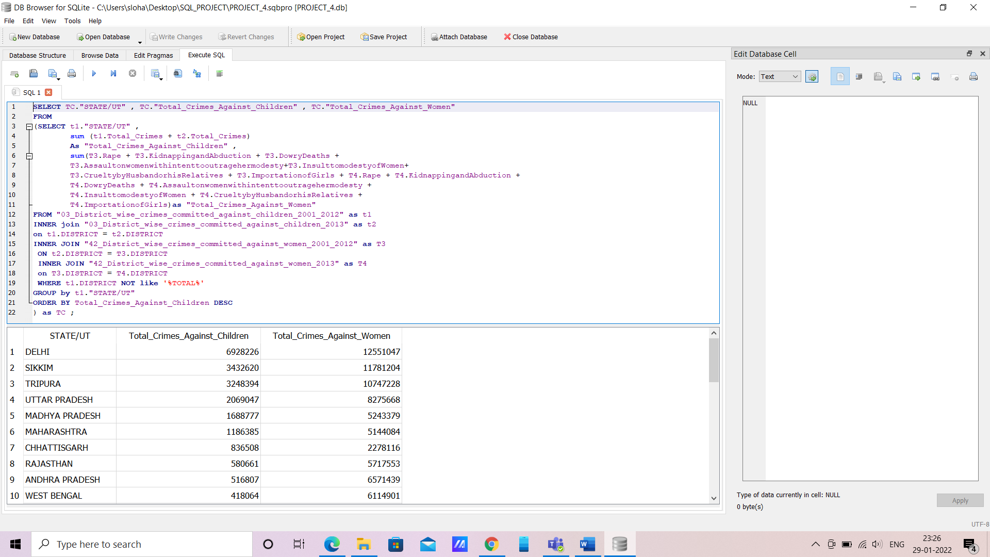

Slide 10
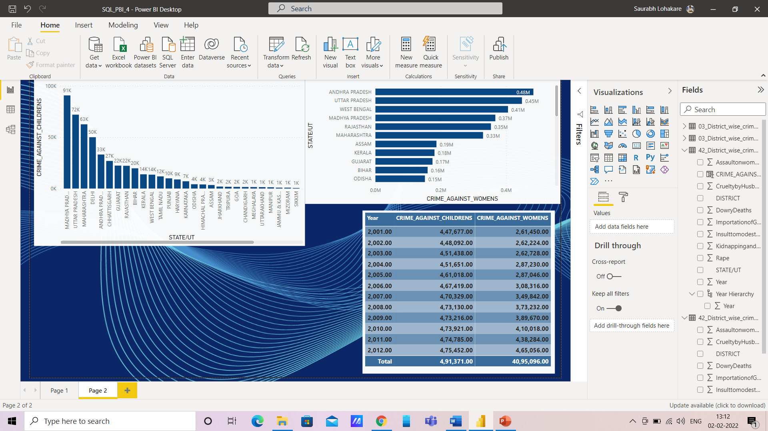
CONCLUSION:
Violence against women & Children in India refers to physical or sexual violence committed against a woman, typically by a man. Common forms of violence against women & Children in India include acts such as domestic abuse, sexual assault, and murder.
Madhya Pradesh reported more crime against Children & Andhra Pradesh has more crime against Womens.
Crime against women are more than against children.

Slide 11
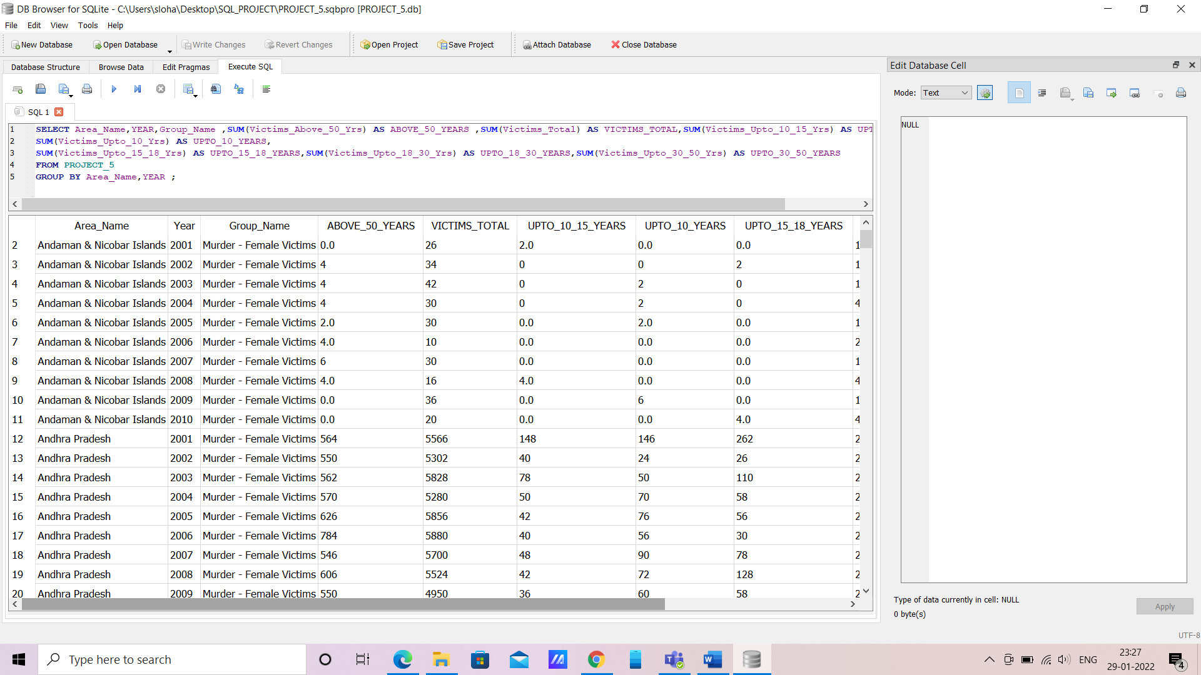
Q5. Age group wise murder victim.
: SELECT Area_Name, YEAR, Group_Name ,SUM(Victims_Above_50_Yrs) AS ABOVE_50_YEARS ,SUM(Victims_Total) AS VICTIMS_TOTAL,SUM(Victims_Upto_10_15_Yrs) AS UPTO_10_15_YEARS,
SUM(Victims_Upto_10_Yrs) AS UPTO_10_YEARS,
SUM(Victims_Upto_15_18_Yrs) AS UPTO_15_18_YEARS,SUM(Victims_Upto_18_30_Yrs) AS UPTO_18_30_YEARS,SUM(Victims_Upto_30_50_Yrs) AS UPTO_30_50_YEARS
FROM PROJECT_5
GROUP BY Area_Name , YEAR ;

Slide 12
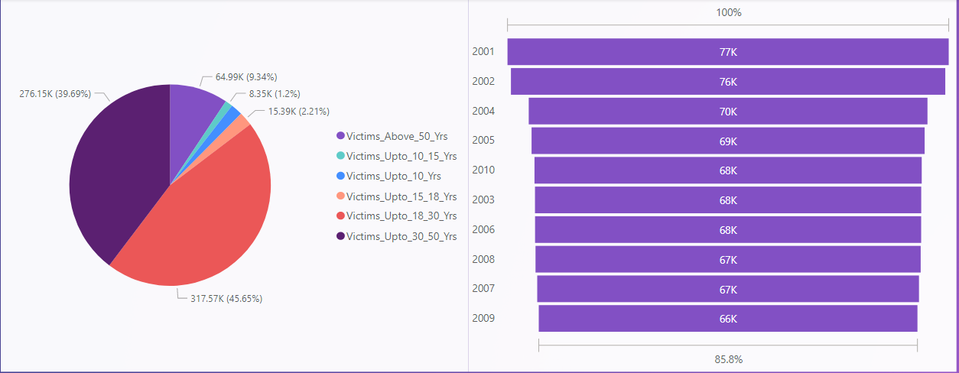
Conclusion :
1) As Per Data Males get murdered more as compared to Females.
2) From graph, we can see that , after year 2002 murder crime has decreased .
3) Especially age group 18 to 30 have the most murder victims and then 30 to 50. Other age groups have relatively less victims.

Slide 13
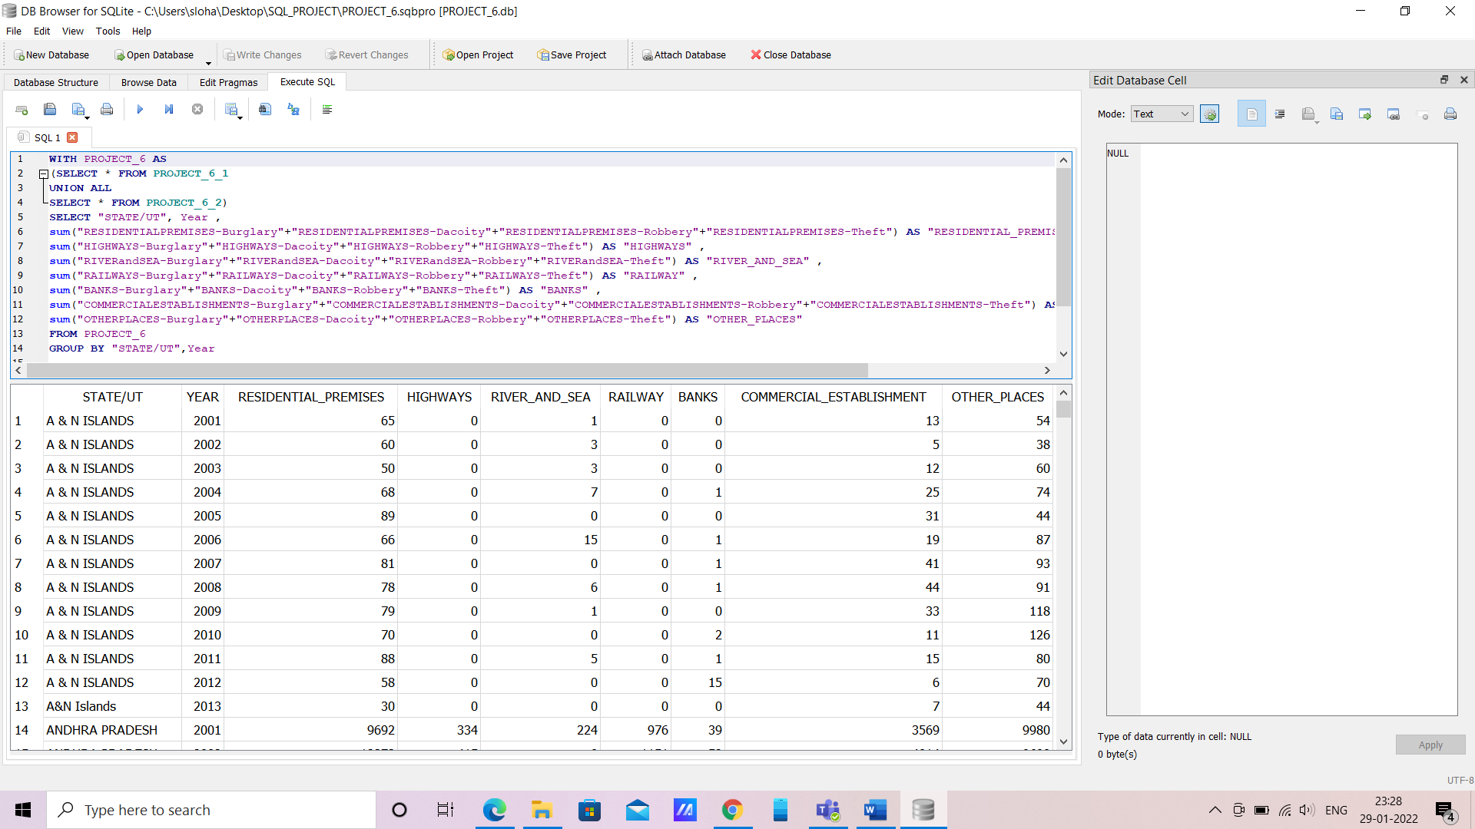
Q6. Crime by place of occurrence.
: WITH PROJECT_6 AS
(SELECT * FROM PROJECT_6_1
UNION ALL
SELECT * FROM PROJECT_6_2)
SELECT "STATE/UT",Year,
sum("RESIDENTIALPREMISES-Burglary"+"RESIDENTIALPREMISES-Dacoity"+"RESIDENTIALPREMISES-Robbery"+"RESIDENTIALPREMISES-Theft") AS "RESIDENTIAL_PREMISES" ,
sum("HIGHWAYS-Burglary"+"HIGHWAYS-Dacoity"+"HIGHWAYS-Robbery"+"HIGHWAYS-Theft") AS "HIGHWAYS" ,
sum("RIVERandSEA-Burglary"+"RIVERandSEA-Dacoity"+"RIVERandSEA-Robbery"+"RIVERandSEA-Theft") AS "RIVER_AND_SEA" ,
sum("RAILWAYS-Burglary"+"RAILWAYS-Dacoity"+"RAILWAYS-Robbery"+"RAILWAYS-Theft") AS "RAILWAY" ,
sum("BANKS-Burglary"+"BANKS-Dacoity"+"BANKS-Robbery"+"BANKS-Theft") AS "BANKS" ,
sum("COMMERCIALESTABLISHMENTS-Burglary"+"COMMERCIALESTABLISHMENTS-Dacoity"+"COMMERCIALESTABLISHMENTS-Robbery"+"COMMERCIALESTABLISHMENTS-Theft") AS "COMMERCIAL_ESTABLISHMENT" ,
sum("OTHERPLACES-Burglary"+"OTHERPLACES-Dacoity"+"OTHERPLACES-Robbery"+"OTHERPLACES-Theft") AS "OTHER_PLACES"
FROM PROJECT_6

Slide 14
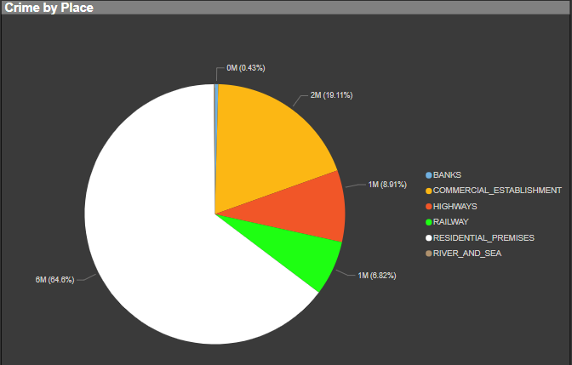
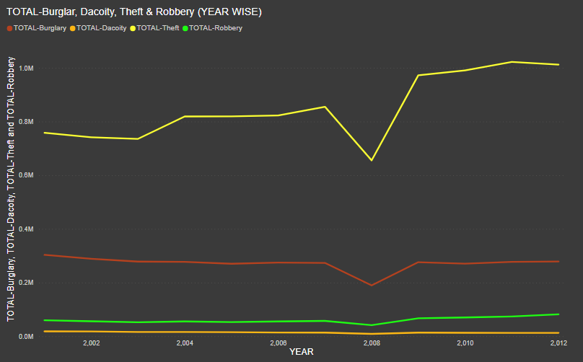
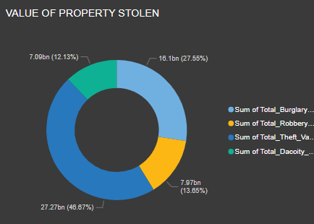
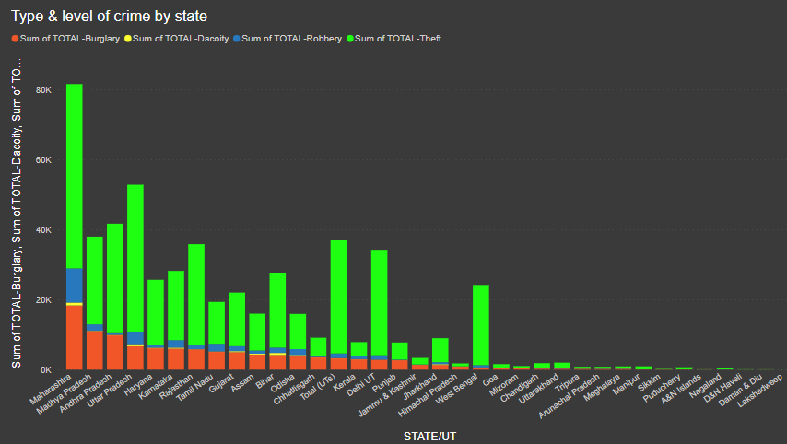
CONCLUSION:
Most of cases are happened in ‘Residential Premises’ and ‘Commercial Establishment’.
Most type of crime was ‘Theft’.
Most stealing crime happened in – 1. Maharashtra 2.Uttar Pradesh 3.Andhra Pradesh
Crime rate is increasing by year. But, in ‘2008’ it was significantly controlled.
Most property was stolen in ‘Theft’ type of crime in year 2014. (no data for other year)

Slide 15
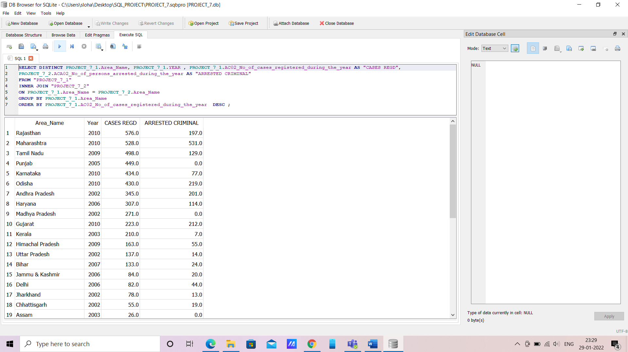
Q7. Anti corruption cases vs arrests.
: SELECT DISTINCT PROJECT_7_1.Area_Name, PROJECT_7_1.YEAR , PROJECT_7_1.AC02_No_of_cases_registered_during_the_year AS "CASES REGD",
PROJECT_7_2.ACA02_No_of_persons_arrested_during_the_year AS "ARRESTED CRIMINAL"
FROM "PROJECT_7_1"
INNER JOIN "PROJECT_7_2"
ON PROJECT_7_1.Area_Name = PROJECT_7_2.Area_Name
GROUP BY PROJECT_7_1.Area_Name
ORDER BY PROJECT_7_1.AC02_No_of_cases_registered_during_the_year DESC;

Slide 16
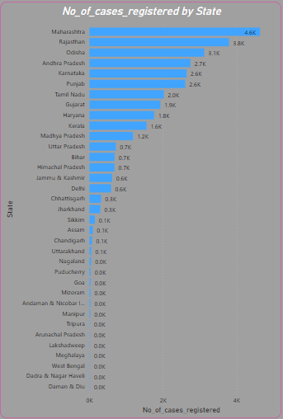
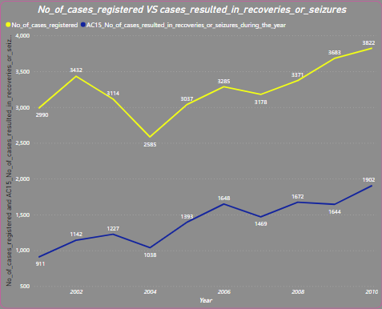
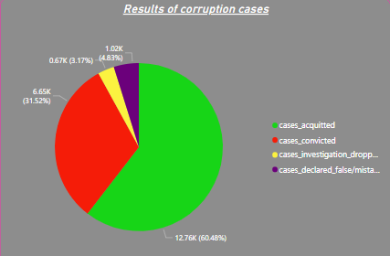
CONCLUSION:
Most of the corruption cases are filed in Maharashtra, Rajasthan , Odisha and so on .
No. of cases found guilty is lesser than those found Not Guilty.
Some of cases are dropped by various reason and some are declared false.
The no.of cases which resulted in Recovery/ Seizures of the property is very less.

Slide 17
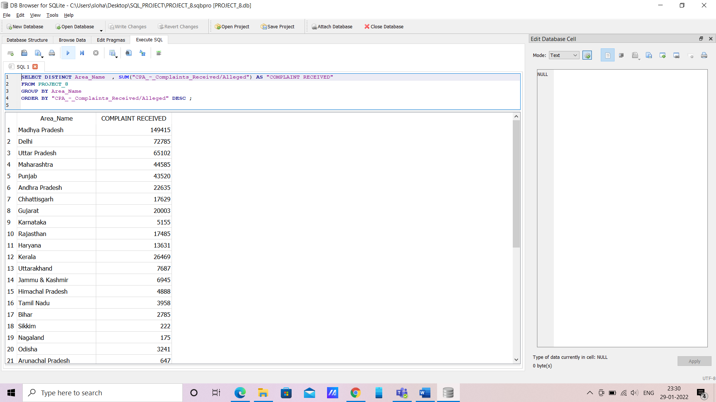
Q8. Which state has more number of complaints against police?
: SELECT DISTINCT Area_Name , SUM("CPA_-_Complaints_Received/Alleged") AS "COMPLAINT RECEIVED"
FROM PROJECT_8
GROUP BY Area_Name
ORDER BY "CPA_-_Complaints_Received/Alleged" DESC ;

Slide 18
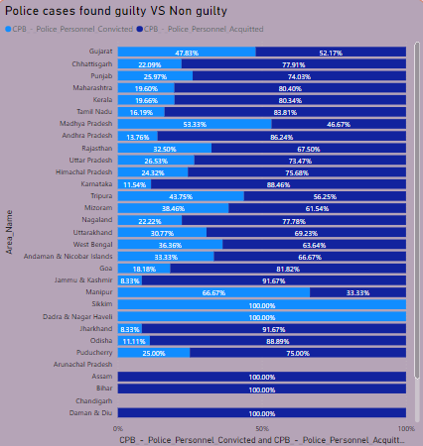
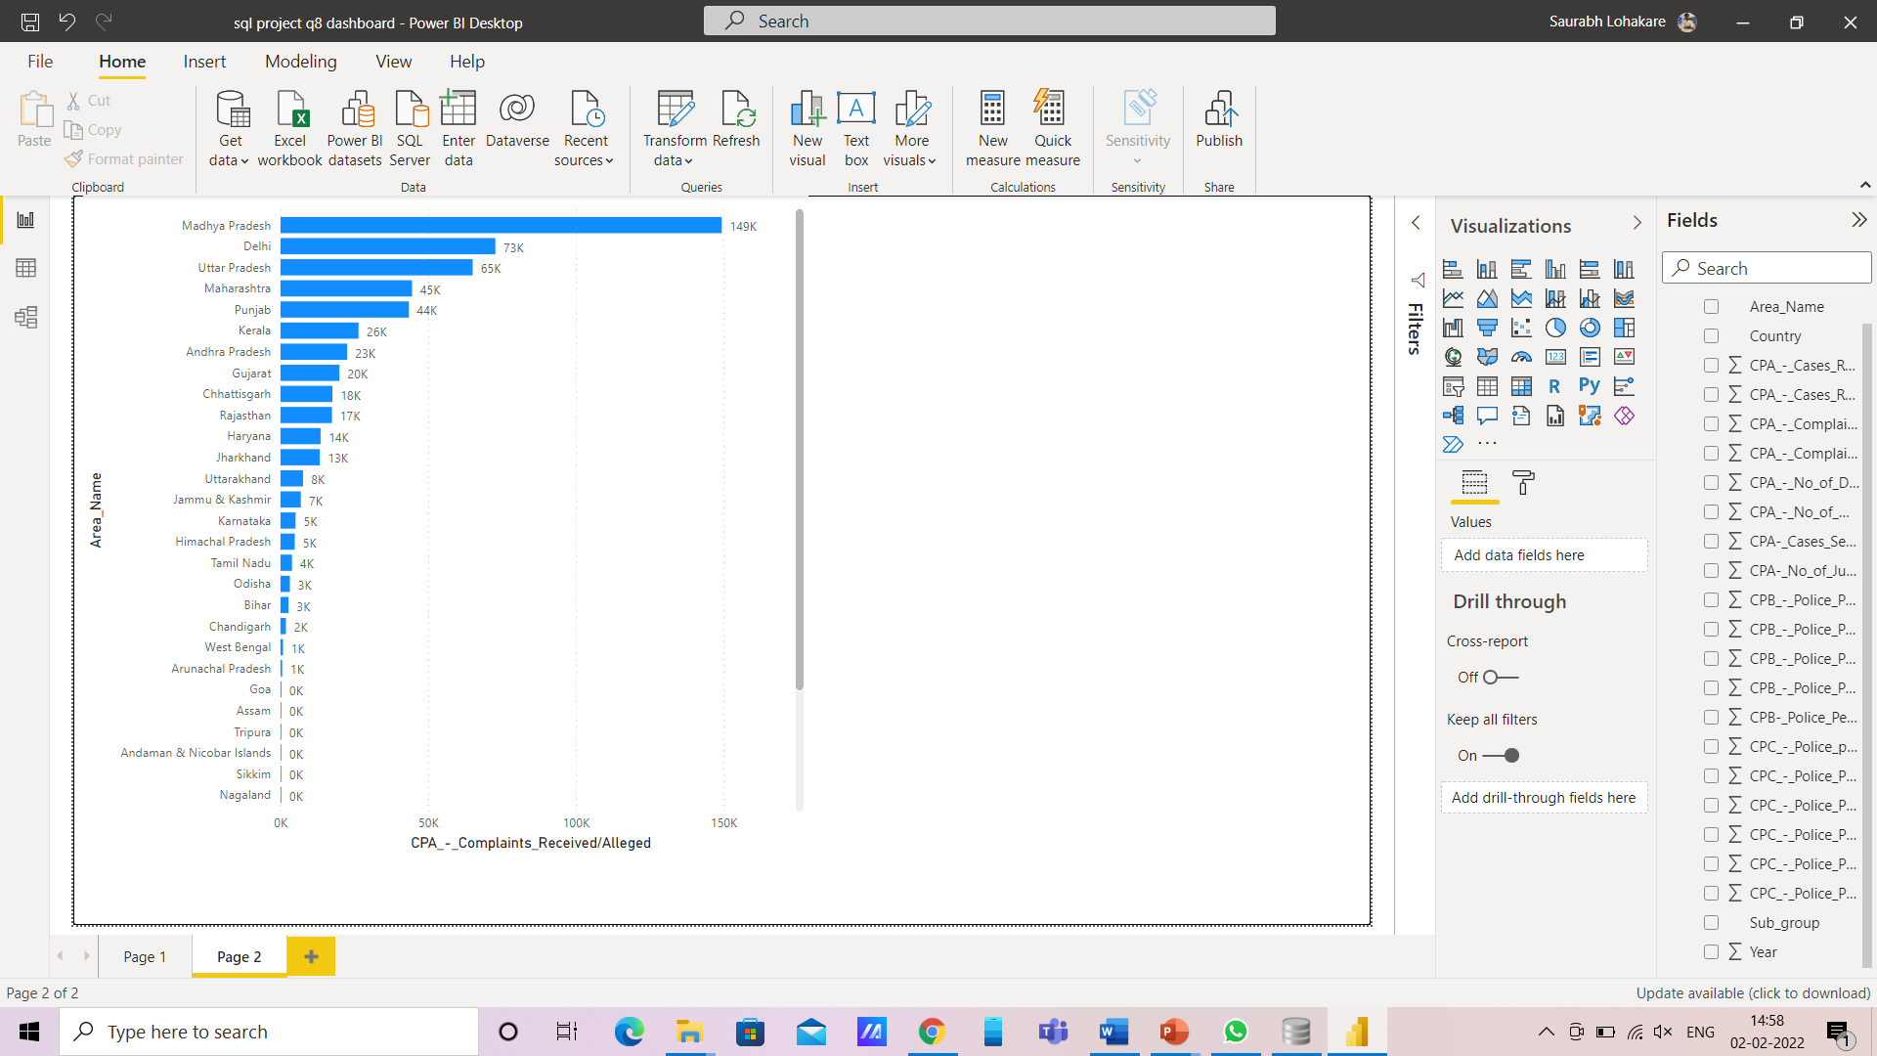
Conclusion:
Most complaints against police officers are filed in ‘Madhya Pradesh’, ‘Delhi’, ‘Uttar Pradesh’ & ‘Maharashtra’.
Police persons found ‘Not Guilty’ in most of the cases. Percentage of convicted (found guilty) is relatively low.

Slide 19
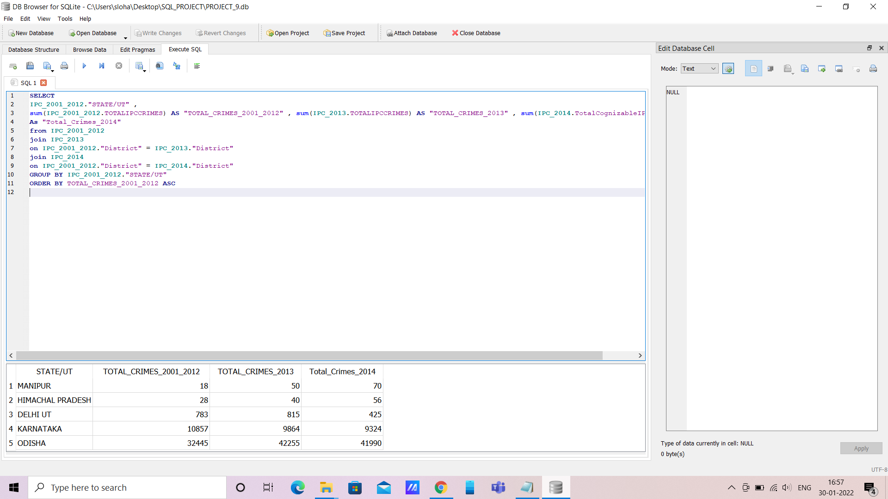
Q9. Which state is the safest for foreigners?
: SELECT
IPC_2001_2012."STATE/UT" ,
sum(IPC_2001_2012.TOTALIPCCRIMES) AS "TOTAL_CRIMES_2001_2012" , sum(IPC_2013.TOTALIPCCRIMES) AS "TOTAL_CRIMES_2013" , sum(IPC_2014.TotalCognizableIPCcrimes)
As "Total_Crimes_2014"
from IPC_2001_2012
join IPC_2013
on IPC_2001_2012."District" = IPC_2013."District"
join IPC_2014
on IPC_2001_2012."District" = IPC_2014."District"
GROUP BY IPC_2001_2012."STATE/UT"
ORDER BY TOTAL_CRIMES_2001_2012 ASC ;

Slide 20
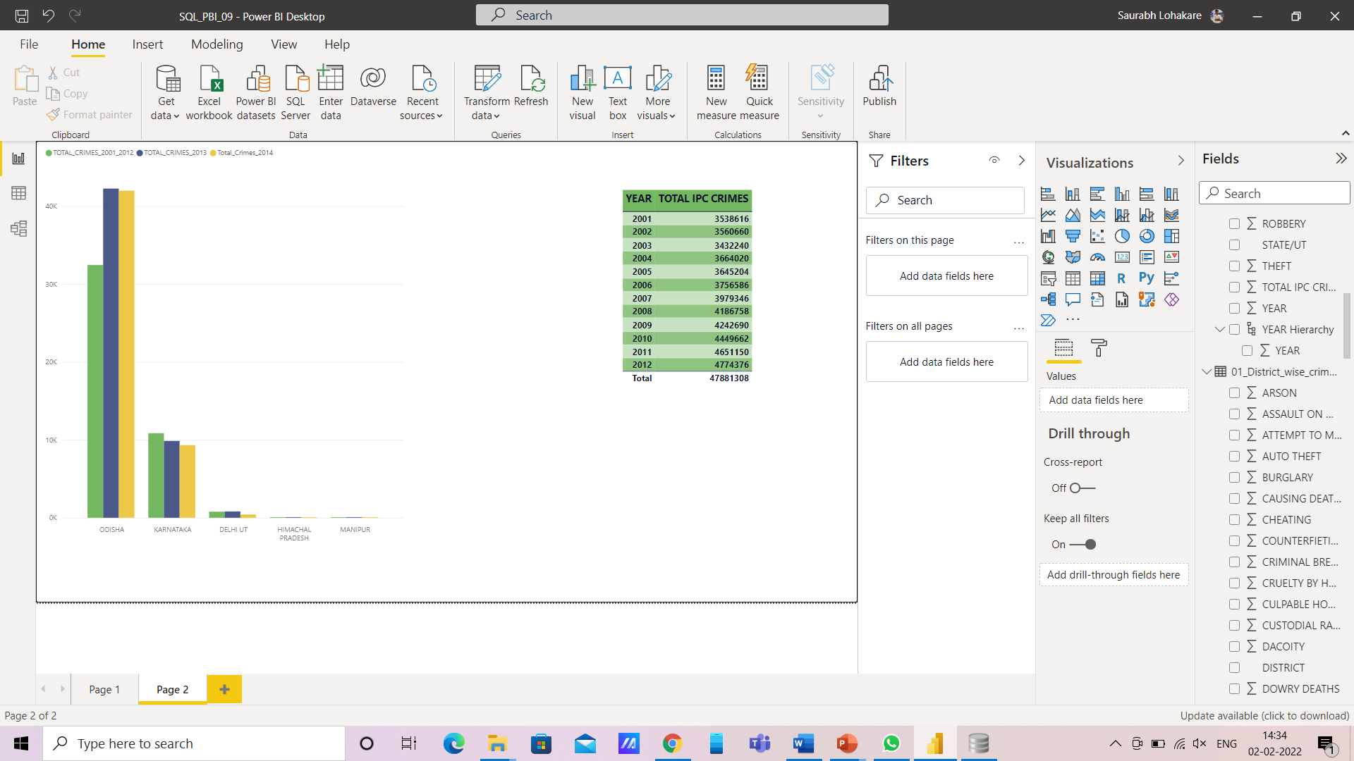
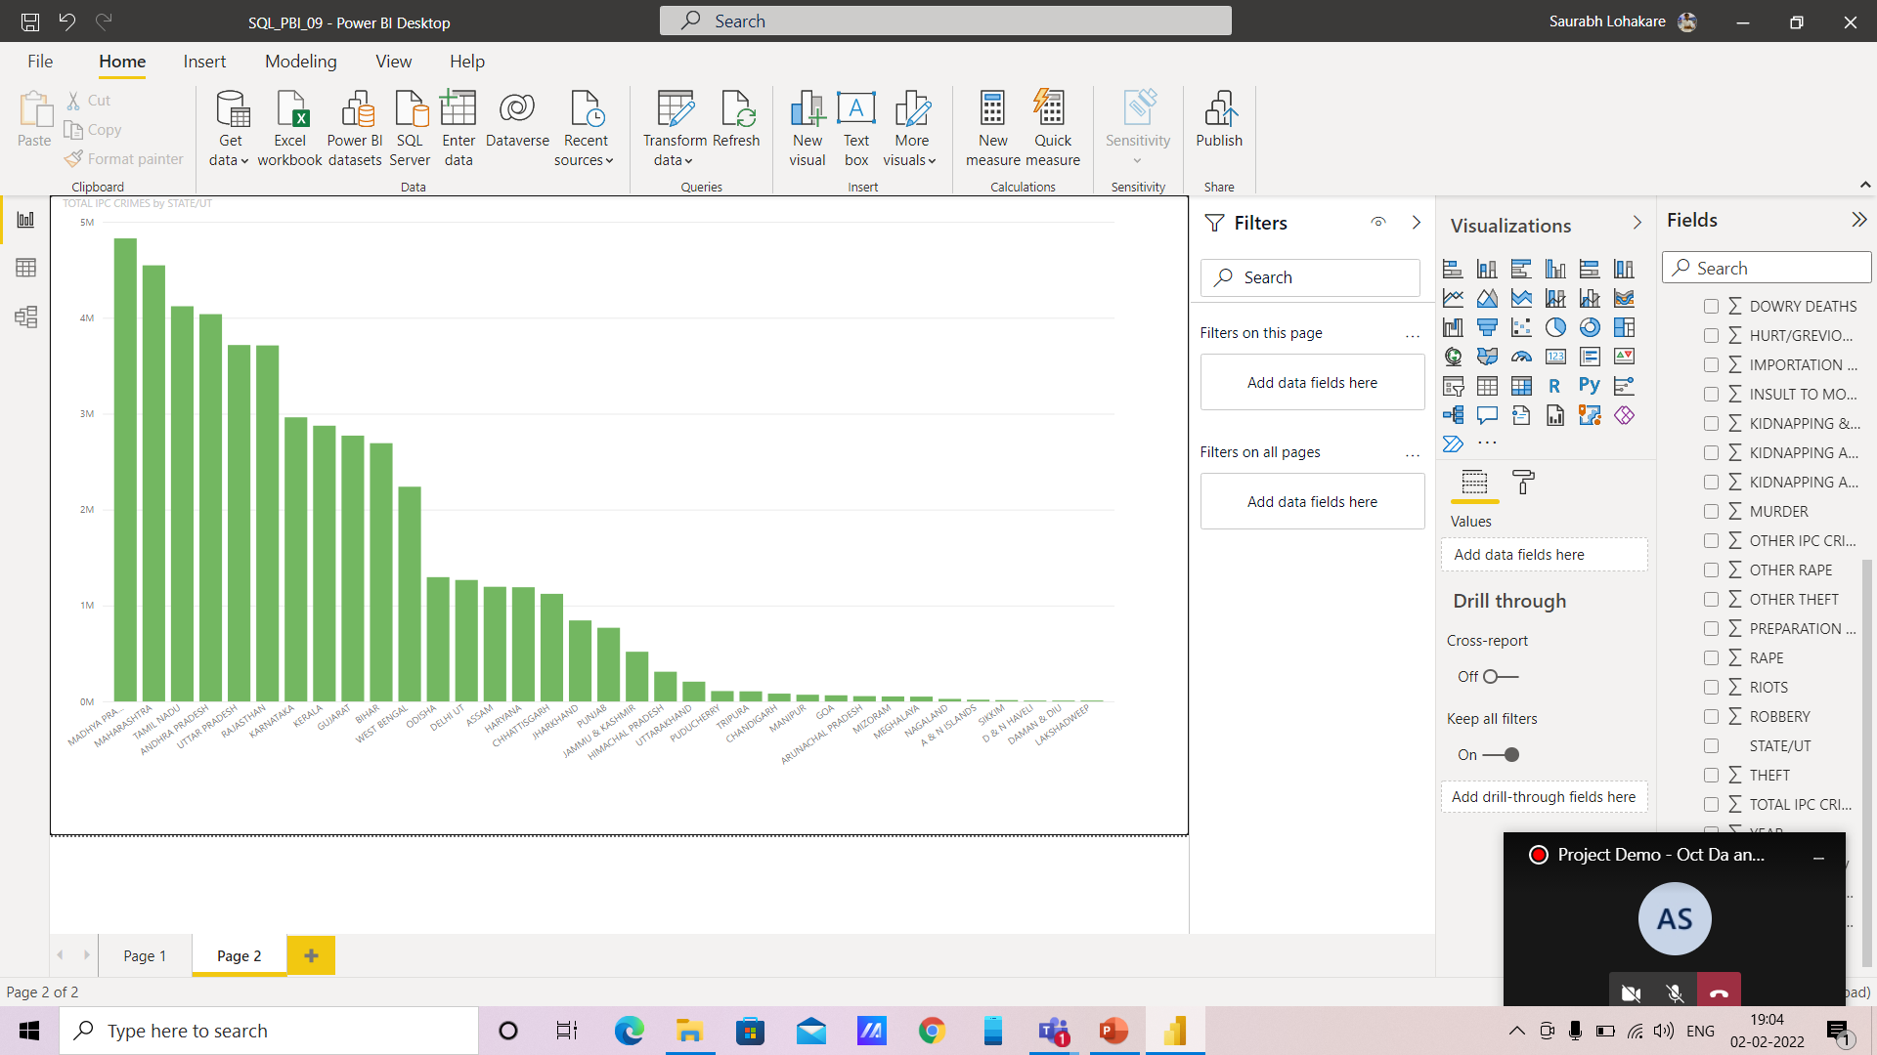
Conclusion :
1) Lakshadweep & other union territories have low crime rate (better control due to less population) i.e. It is the safer state for Foreigners.
2) Maharashtra has more crime cases registered.
3) Year wise crime rate is increasing gradually up till 2012.

